Slide 1
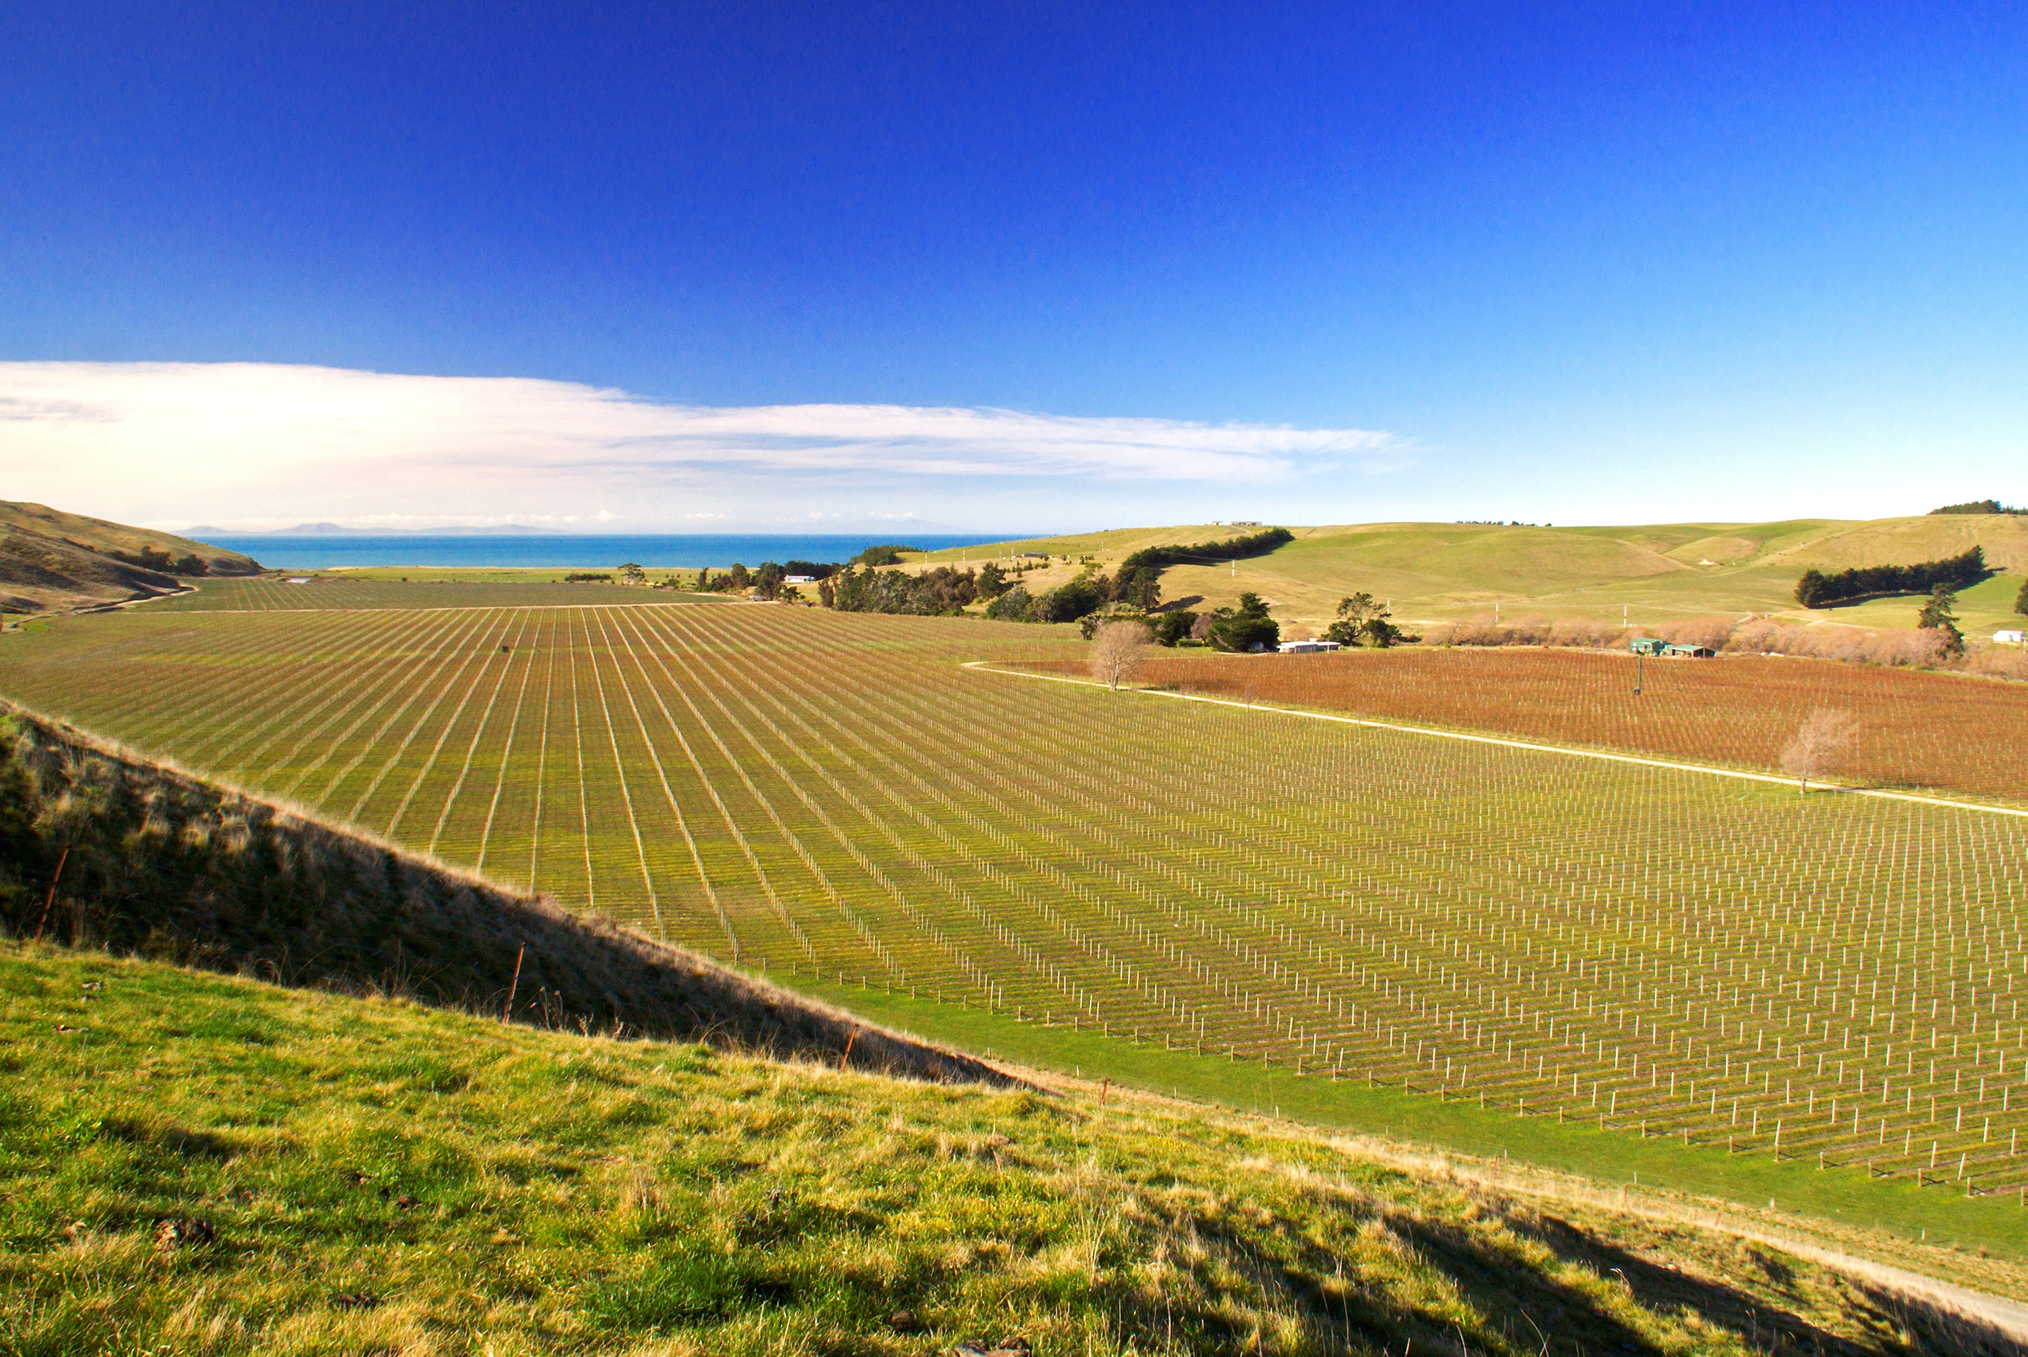
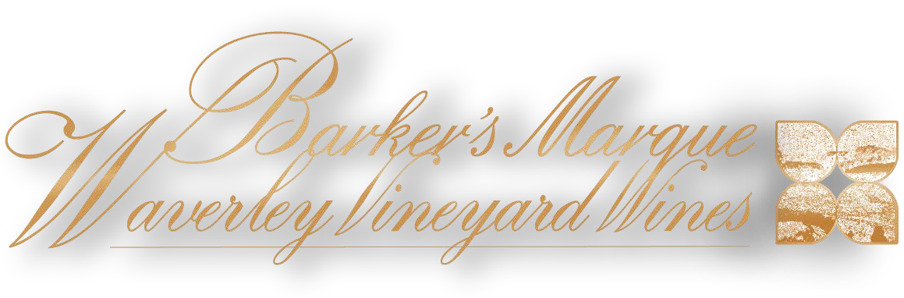

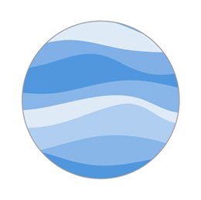




Estate & Single Vineyard Wines from Blind River, Marlborough, New Zealand
PR KIT 2026

Slide 2
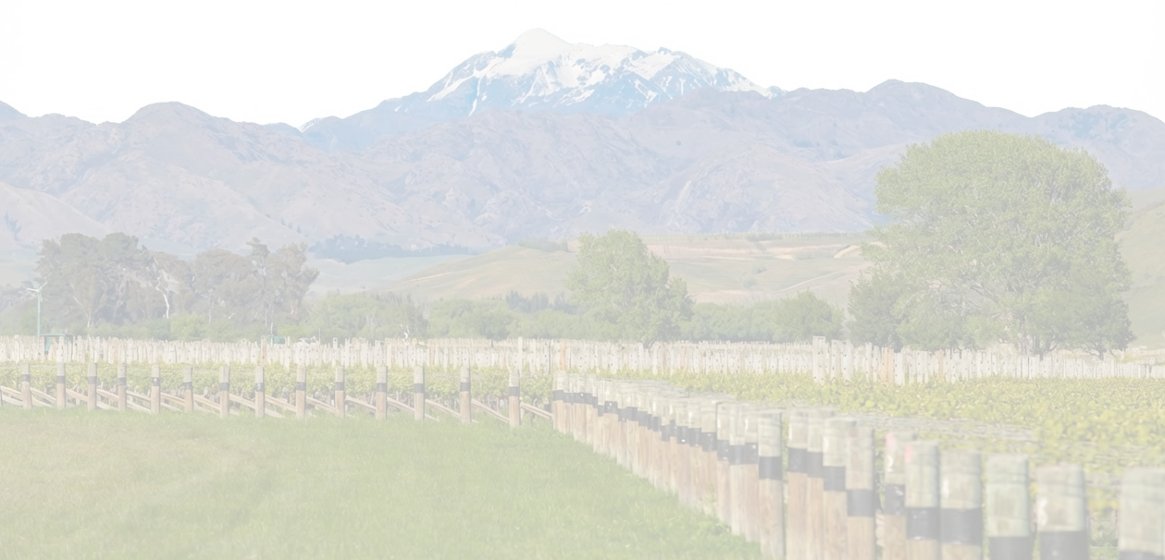
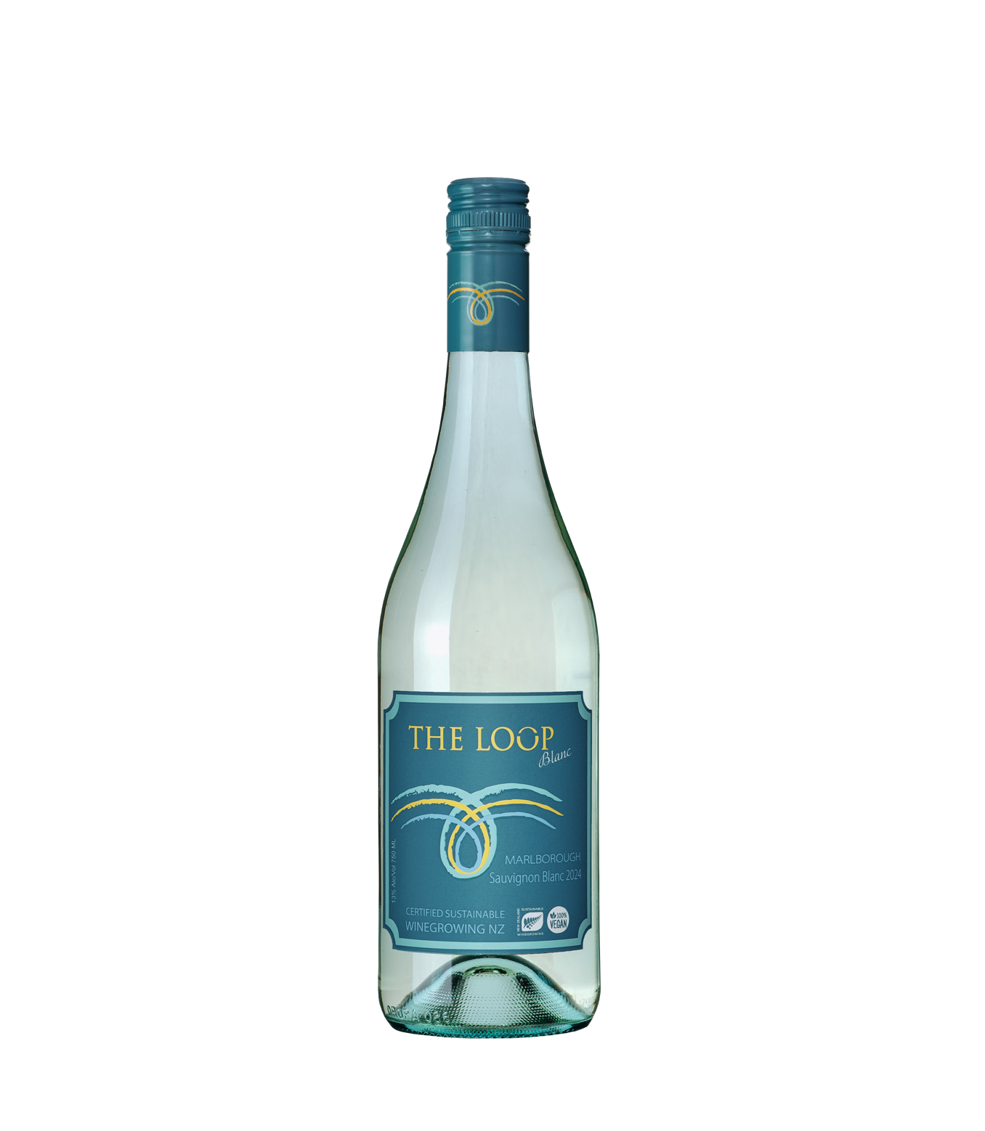
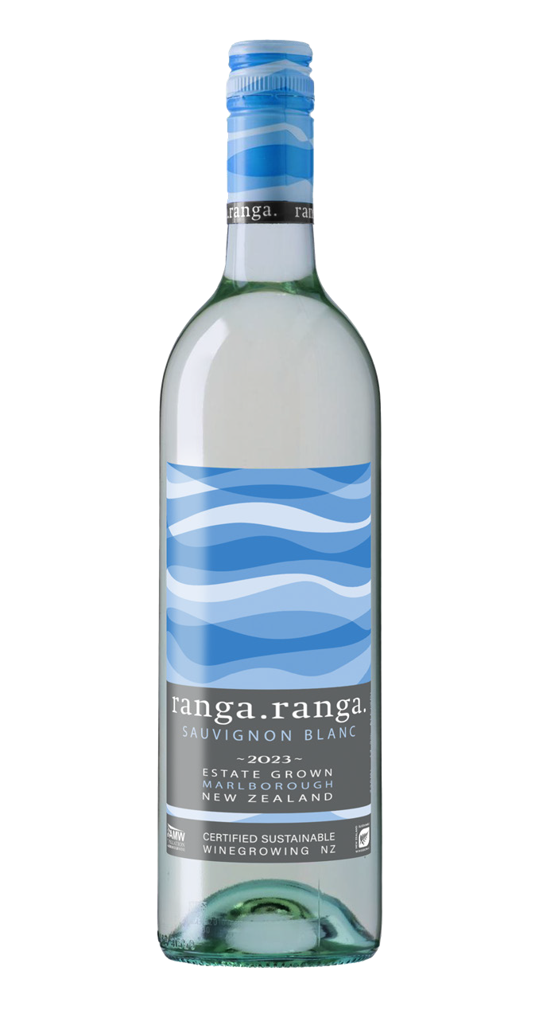
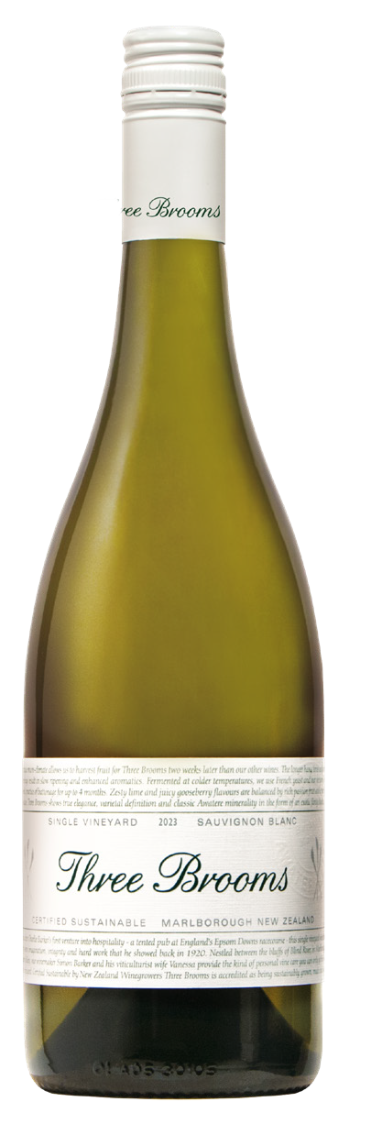
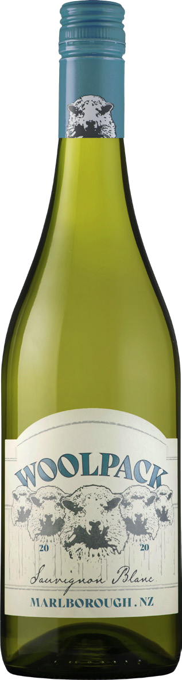
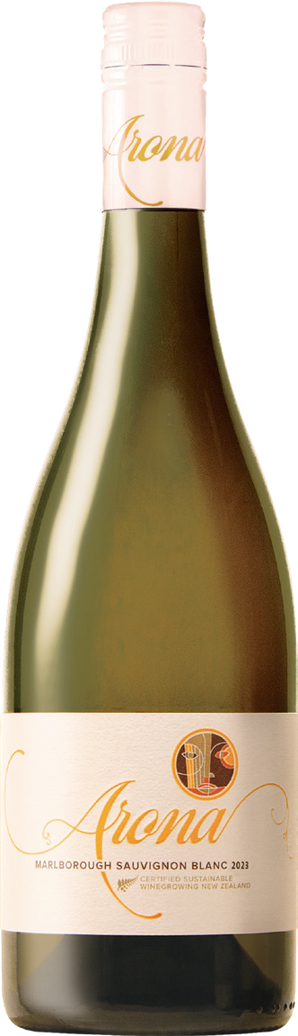
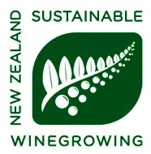

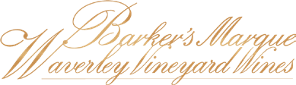

Single Vineyard Wines from Blind River, Marlborough
Barker's Marque - Waverley Vineyards produces a focused portfolio of Sauvignon Blanc wines drawn from a single, contiguous vineyard in Blind River. While the site itself remains constant, each wine is shaped by deliberate choices in harvest timing, parcel selection, and winemaking approach, allowing different aspects of the vineyard to be expressed.
“ Our wines are certified under the Sustainable Winegrowing New Zealand program (SWNZ) requiring the vineyard, winemaking and bottling to be sustainably certified.”
The range explores four interpretations of Sauvignon Blanc from a similar place, highlighting variation within the vineyard rather than variation between regions. Each bottling reflects a distinct perspective of Blind River, created with the intent to show how one vineyard can give rise to multiple expressions. Together, the wines form a cohesive collection - unified by origin, yet individual in character - offering a detailed look at Blind River through Sauvignon Blanc alone.
Why Blind River
Blind River is one of Marlborough's youngest and most distinctive sub-regions. Shaped by strong coastal winds, gravelly clay soils,
and wide diurnal shifts, the area produces Sauvignon Blancs with structure, definition, and a clear regional signature.
This rugged environment naturally limits yields and encourages long, even ripening, allowing wines from Blind River to express character and place with clarity.
“ One vineyard, explored through multiple expressions of Sauvignon Blanc”
01

Slide 3
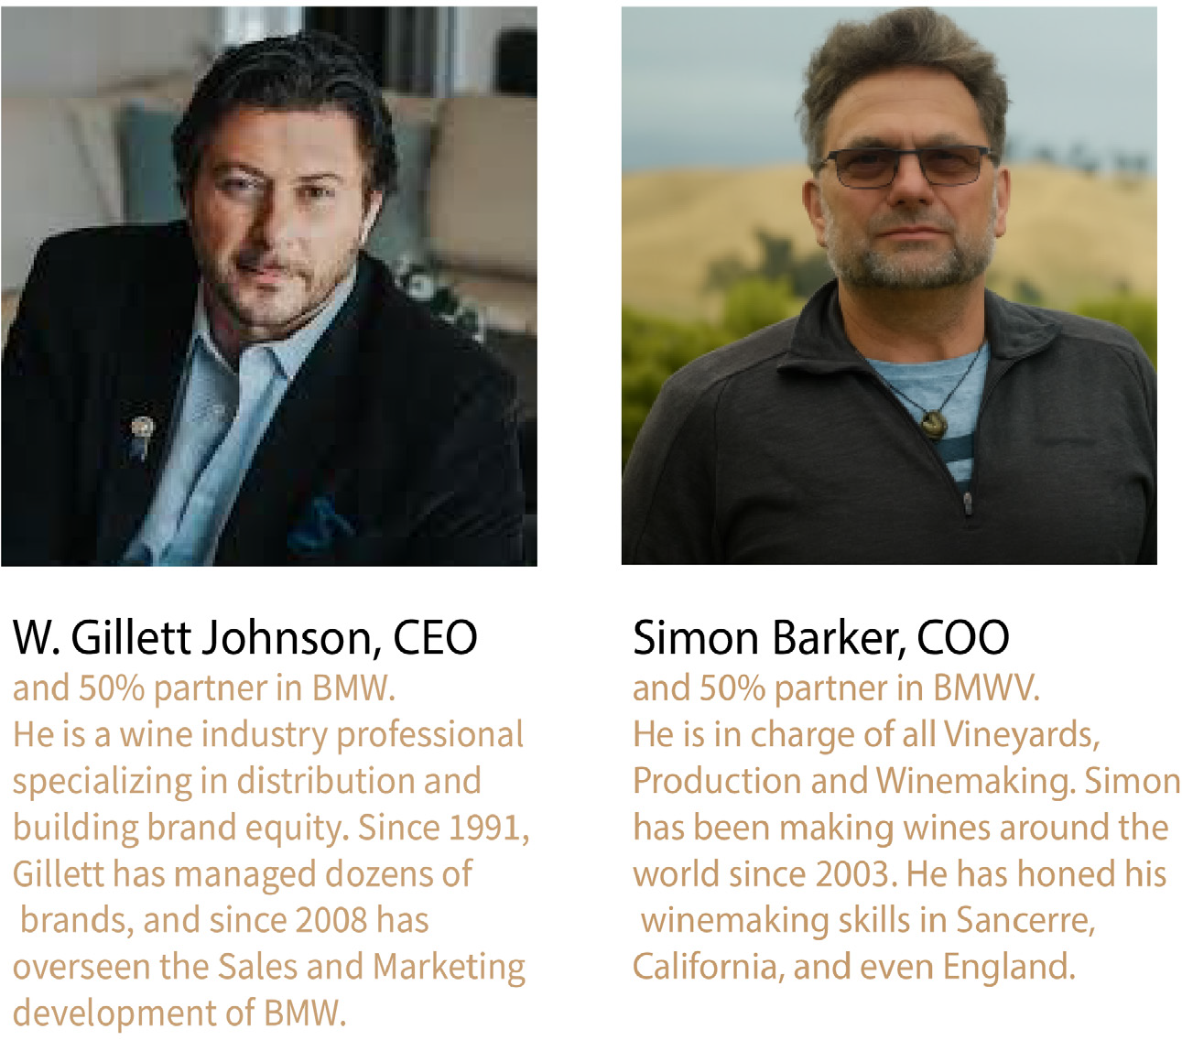

Our Story
www.barkersmarquewines.com
Barkers Marque – Waverley Vineyards offers award-winning wines from Blind River, Marlborough, New Zealand. These are the kind of wines that enthusiasts are looking for from this land of discovery – clean, fresh, intense and exotic wines of the highest caliber. They come from unique terroir with a unique profile.
Our four distinctive Sauvignon Blancs and single estate Riesling, represent the finest wines in the region. Driven by a passion for wine, and for bringing exceptional quality to our customers, our aim is to enjoy “the ride” while building our wine business. We value integrity, openness and transparency and truly minimal intervention between vine and wine. We keep things focused and simple and plan to continue what we are doing for many years to come. Setting out to make a wine of distinction was our goal – only to find that if we were to be true to making the best“wine” we would need to listen to the vineyard – which told us that there were 4 distinguishable wines that were present. Using Simon's vast international winemaking experience, and Vanessa’s viticultural expertise, 5 wines emerged from the one contiguous vineyard we planted in 2004 and 2005.
“If we wanted to make the best wine,
we knew we had to listen to the vineyard first.”
Our price advantage comes not by scrimping on quality or process, but by building direct
and trusted partnerships. Because we grow, make, and import the wine to the U.S, we can offer superior value. The New Zealand branch can be found on the Waverley Vineyard in Blind River on the southeastern corner ofMarlborough’s wine growing region. Simon Barker - wine-maker, and his viticulturalist wife Vanessa live here with their family, to keep a daily eye on vineyards and winemaking.
02

Slide 4
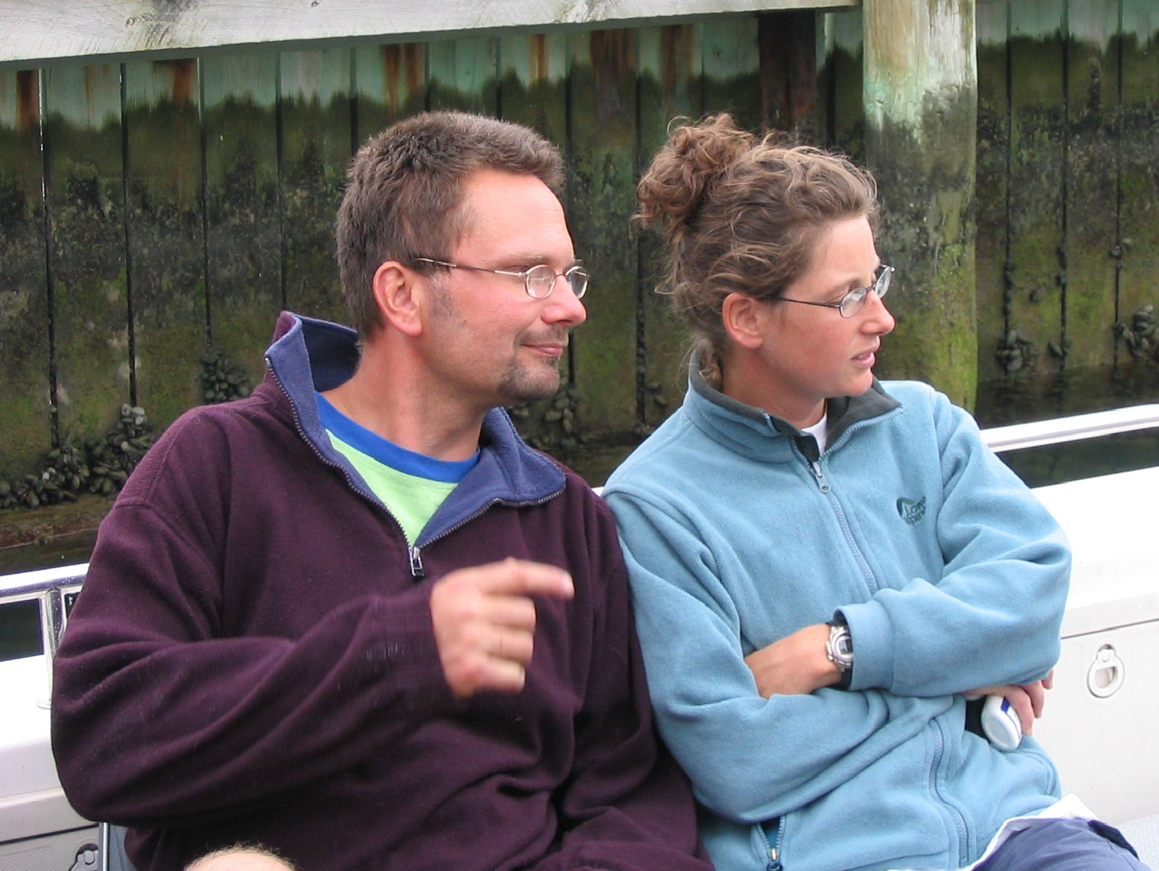
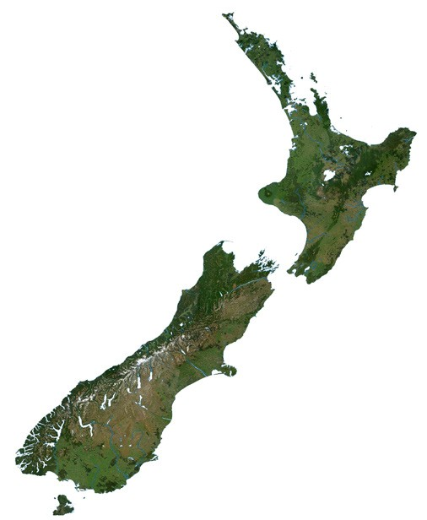
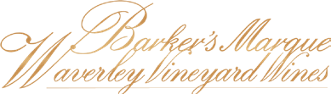
Our Philosophy
www.barkersmarquewines.com
We create wine that is honest and representative of this region. Wine that reflects the true character of the Blind River terroir of the vineyard that is our home. Wine that adds texture and balance to the intensity of the world-famous Marlborough Sauvignon Blancs.
Our belief is that winemaking starts in the vineyard…and that fruit carefully tended and managed using sensible, sustainable methods requires minimal intervention from the winemaker for our terroir to show its potential. The result is wines of quality with unique flavour profiles—wines with a freshness and minerality not found else-where in Marlborough. We judge ourselves as a reflection of our wines and the place they represent. As a cool climate region, we expect variation between vintages. We continually seek improvement by blending our wines and conducting fining trails blind, rather than repeating last year’s process. And our process is transparent.
While the majority of our wines are sourced from our own vineyard, we tap some grapes for the winemaking mix from other vineyards we manage in Blind River, and who share
our views on care and sustainability.
Simon Barker – Winemaker & Vanessa Barker – Vinticulturalist
“Great wine begins in the vineyard -
our role is simply not to get in its way”
The Vineyard - Distinctive Terroir
Simon and Vanessa extensively researched the soil and climate in the Marlborough region, and discovered that Waverley’s terroir would produce wines of exceptional quality and character. The soil at Waverley is diverse — with areas of clay that holds water in the soil and nourishes vine’s root system.
Waverley is located less than a mile from the sea in one of the windiest areas of Marlborough. The sea breeze makes vines less prone to disease, allowing fewer treatments.
Winds from the sea and mountains also reduces temperature, lowering yields and delaying maturity so the grapes sees more of the cooler fall evenings. The larger diurnal temperature difference helps develop aromas and flavors that give our wines their individual intensity.
In line with Minimal Intervention, our wines are made “in the vineyard”. Our viticultural, and winemaking has practically become one and the same at Waverley.
03

Slide 5
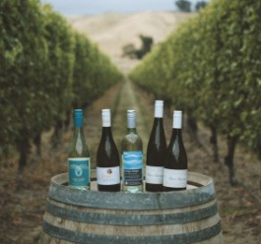
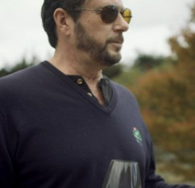
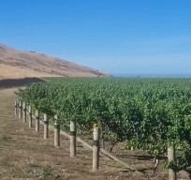
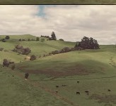
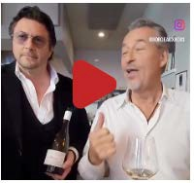
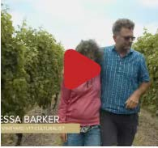

Interactive Sheet
www.barkersmarquewines.com
Click play buttons for reels
REELS
04

Slide 6

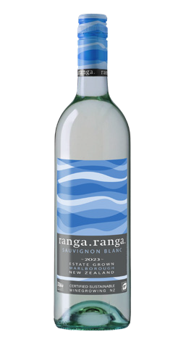
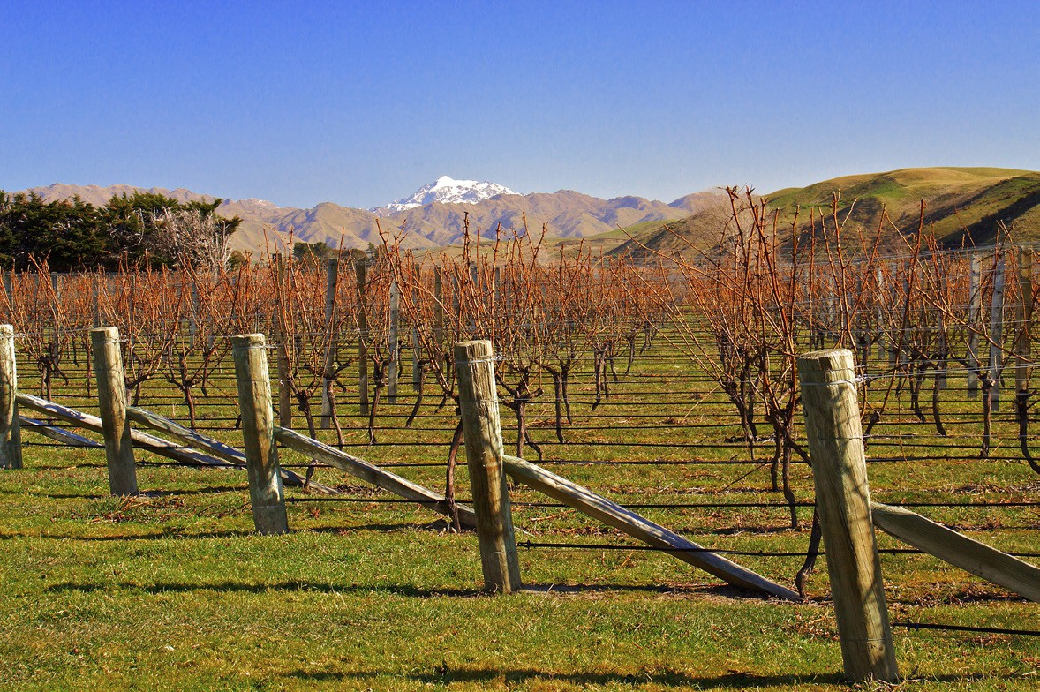
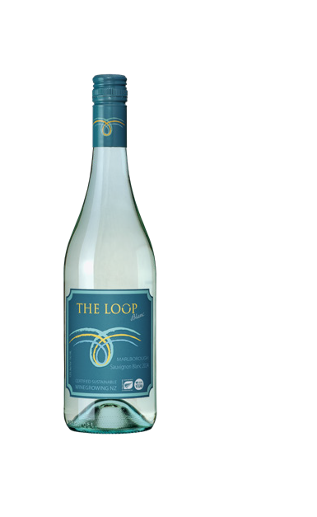
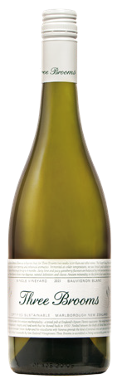
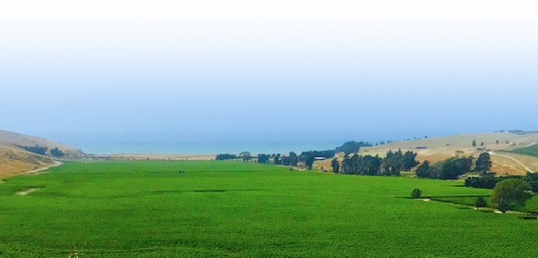

Barker's Marque - Waverley Vineyards Wines
www.barkersmarquewines.com
Arona
”A beautiful young mademoiselle, fruity, open, friendly – very approachable.”
ranga.ranga
“A feisty teenage boy, it’s fresh, it’s vibrant – full of life”.
A riper more tropical and exotic expression of our SB. Pineapple core and stone fruit make this dynamic alternative to MSB.
Crisp with hints of lemon grass and dried herbs complimenting deep range of sweet citrus flavors.
The Loop
“Mom…– kind and gentle but with
a backbone of steel. Very Complex and incredibly intriguing”.
Three Brooms
”The patriarch of the family, Big, intense, but with incredible depth”
A perfect balance of showcasing garden fresh legumes and round tropical and melon fruits.
Barker's Marque - Waverley Vineyards Wines produces a focused portfolio of Sauvignon Blanc wines from a single vineyard in Blind River, NZ. Each wine represents a deliberate interpretation of the same site, shaped by parcel selection, harvest timing, and winemaking intent rather than by variation in location.
Lush and floral - the nose jumps out of the glass with hints of Kiwi fruit, gooseberry, pink grapefruit and herbs.
“These four wines, they’ve grown up together and I think of them as a family of wines…”
Simon Barker - Winemaker
Together, the wines form a cohesive range that explores the breadth of expression possible within one vineyard, setting the stage for the individual wines that follow.
“Different expressions,
shaped by a single vineyard”
05

Slide 7


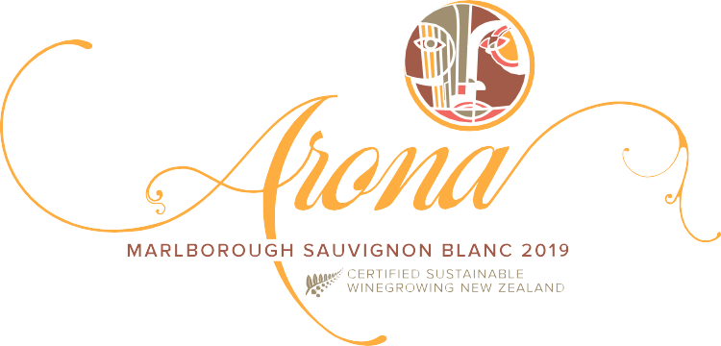





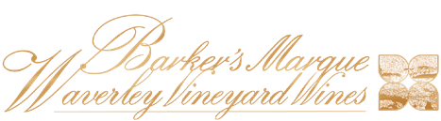
Arona Sauvignon Blanc - Three Brooms Sauvignon Blanc
Arona Sauvignon Blanc
Arona is shaped to present the warmer side Waverley Vineyard, drawing from the more inland area of the vineyard. It shows its unique characteristics within
the Barker's Marque Waverley Vineyard Wines range, offering a composed and cohesive expression of Blind River Sauvignon Blanc.
The wine reflects a philosophy of balance and proportion, guided by careful harvest timing and restrained winemaking. Decisions in the vineyard and cellar are made
with the intent to allow the character of the site to emerge clearly, without exaggeration or overt intervention. Arona consistently represents the core identity of the vineyard, expressing place through measured structure and depth.
Three Brooms Sauvignon Blanc
A layered expression shaped by specific vineyard parcels and intent.
Three Brooms is the flagship wine of the Barker's Marque Waverley Vineyard Wines Sauvignon Blanc range, created to explore the depth and structure possible within the Waverley Vineyard. It is shaped through careful parcel selection and timing, allowing individual components of the site to contribute to a more complex expression.
The wine reflects a deliberate approach in both the vineyard and cellar, where decisions are made to build dimension without obscuring the character of Blind River.
Rather than aiming for uniformity, Three Brooms embraces variations of yeast, extended lees contact, and extremely cold fermentation temperatures.
06

Slide 8

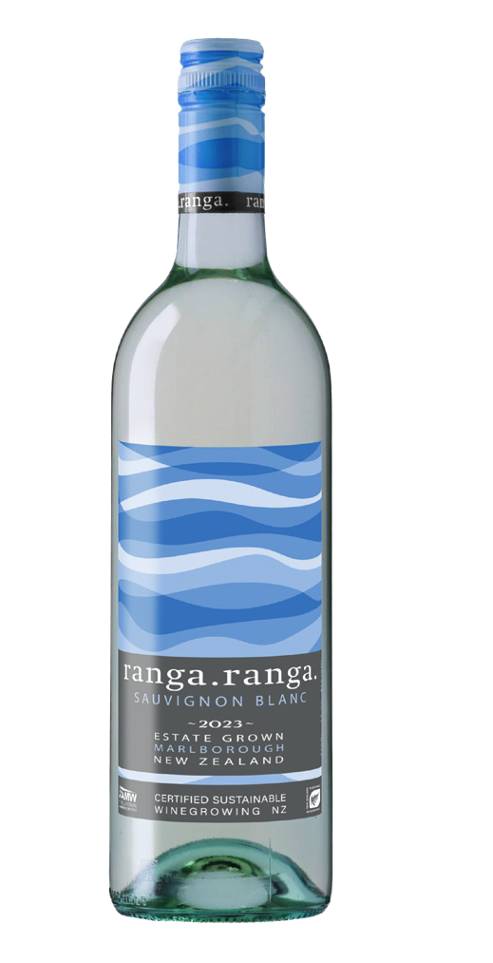

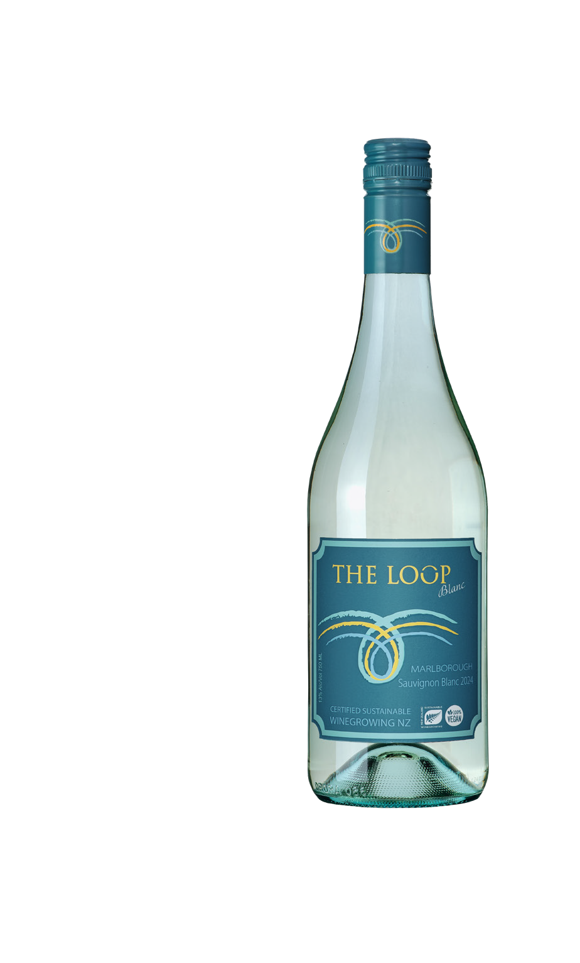
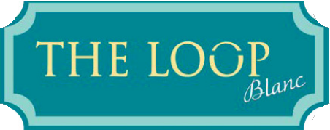

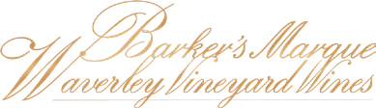

ranga.ranga Sauvignon Blanc - The Loop Sauvignon Blanc
ranga.ranga Sauvignon Blanc
Bold, vibrant, and unmistakably Awatere Valley, ranga.ranga is our most expressive take on Marlborough Sauvignon Blanc.
Fresh citrus and passionfruit leap from the glass, layered with notes of lime zest, crushed herbs, and a subtle saline minerality that reflects the coastal influence of Blind River. The palate is lively and focused, with bright acidity and a crisp, refreshing finish.
This is a wine made to be enjoyed young and shared generously - energetic, approachable, and full of character.
The Loop Sauvignon Blanc
A site-driven expression shaped by place and purpose.
The Loop is drawn from fruit grown along the southern edge of the Waverley Vineyard, an area known locally as "The Loop" and long regarded by our winemaker as one of the most distinctive parts of the site. Rather than presenting the vineyard as a whole,
this wine focuses on a specific zone, capturing a more nuanced and layered expression of Blind River Sauvignon Blanc.
The wine is shaped with food in mind. Harvest timing and winemaking choices a
re quided by the intention to retain freshness while building texture and complexity, allowing the natural characteristics of the Awatere Valley to come through clearly.
The result is a wine that balances bright citrus energy with savory detail and mineral depth. Crisp citrus flavors form the backbone, supported by notes of lemongrass,
lime zest, cut lawn, dried herbs, and a distinctive Awatere minerality.
The palate is composed and precise, offering clarity, structure, and a long, refreshing finish.
07

Slide 9



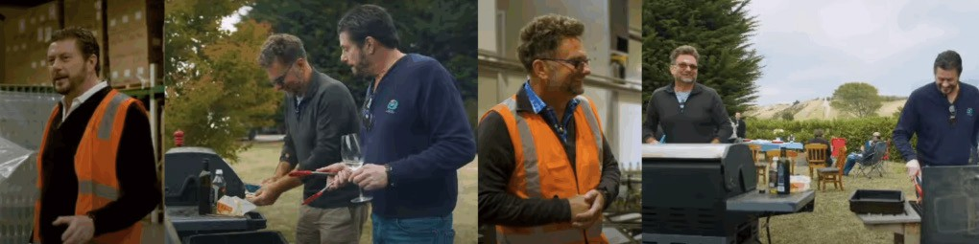
Woolpack Sauvignon Blanc
Woolpack Sauvignon Blanc
Woolpack is a wine that comes from the vineyard of our friends down the road who share a very similar growing philosophy as we do.
Woolpack is shaped to highlight a distinct expression, emphasizing purity of fruit and a clear sense of Blind River. This wine focuses on the breadth of Terroir, drawing attention to the natural structure and freshness that define Blind River Sauvignon Blanc.
Careful harvest timing and restrained winemaking guide the wine's development, allowing balance and proportion to take priority. Decisions in the vineyard
and cellar are made to preserve energy and detail, ensuring the character of the site remains at the forefront without overt manipulation. The palate is bright and composed, showing citrus-driven freshness supported by subtle herbal notes and mineral tension.
The wine finishes clean and focused, offering a clear, confident expression of the vineyard and its growing conditions.
08

Slide 10
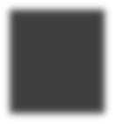
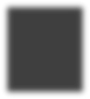
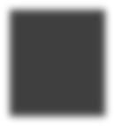
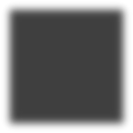
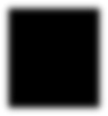
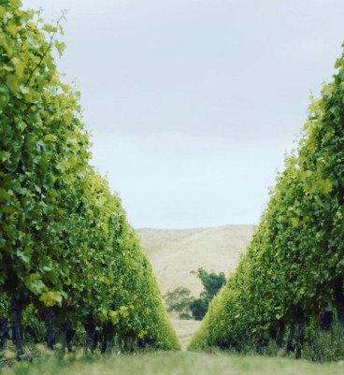
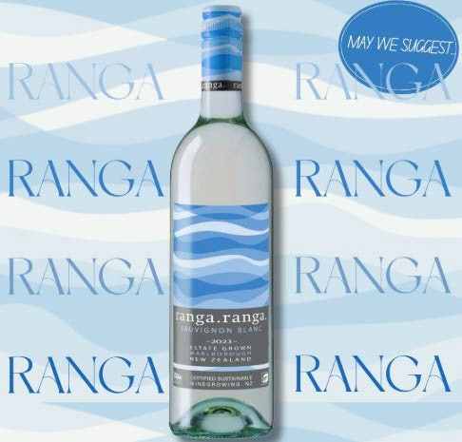
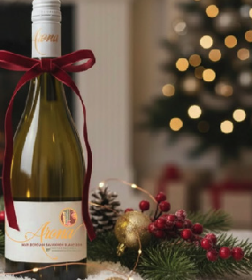
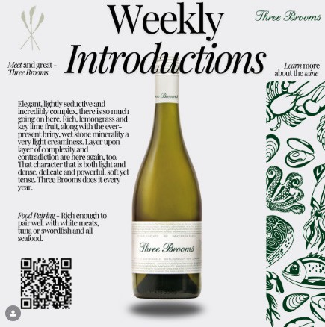
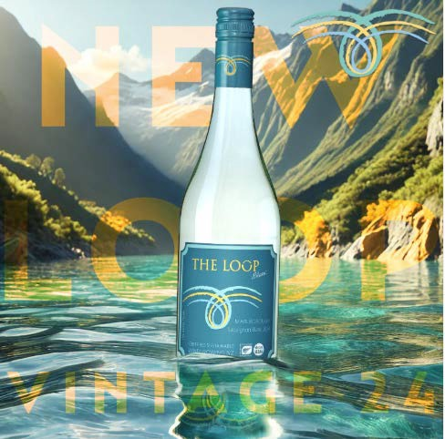
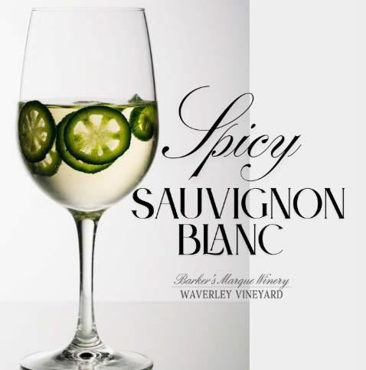

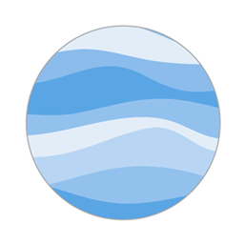




Interactive Sheet
Click graphics for posts - Click icons for Winemaker Notes
POSTS
WINEMAKER NOTES
09

Slide 11
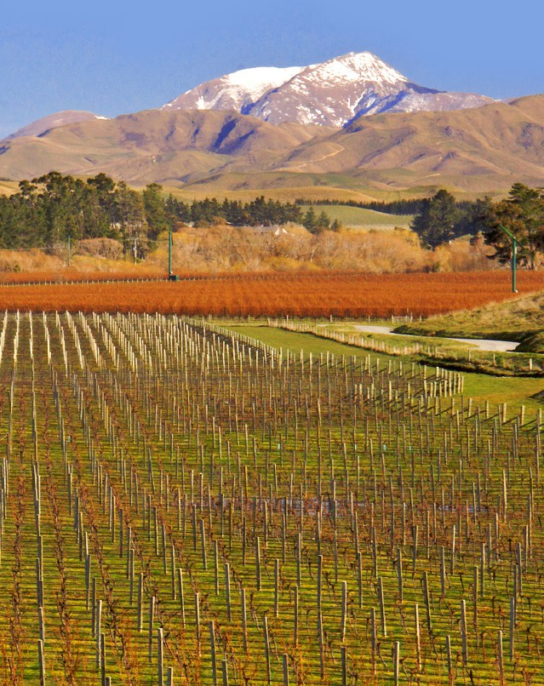





Press & Publications
Contact
Gillett Johnson – Proprietor : 415.305.8622
gillett@internationalvines.wine
Selected Coverage
Barker's Marque has appeared in trade and lifestyle publications focusing
on vineyard expression, sustainability, and the evolving identity of the Blind River sub-region.
Editorial Themes
Estate & Single vineyard Sauvignon Blanc from Blind River, AwatereValley, Marlborough
Sustainable/Vegan winegrowing and estate practice
Vineyard-driven winemaking
Co-proprietors from the UK and the US founded the winery
Radical fermentation techniques drive unique MSB taste profile
Regional expression within Marlborough
Awatere Valley – the other MSB
Press Resources
High-resolution images, video assets, technical sheets, and additional information are available upon request.
Link to Logos and Images
Download .pptx
Press Contact
Barker's Marque - Waverley Vineyard Wines www.barkersmarquewines.com sales@internationalvines.net gillett@internationalvines.wine
Social Media Channels
10

